Slide 1


Slide 2
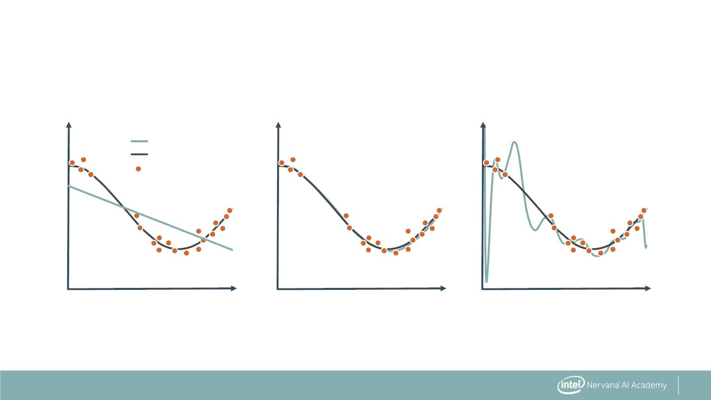
Choosing Between Different Complexities
Polynomial Degree = 1
Polynomial Degree = 4
Polynomial Degree = 15
Model
True Function
Samples
Y
Y
Y
X
X
X
3

Slide 3
How Well Does the Model Generalize?
Polynomial Degree = 1
Polynomial Degree = 4
Polynomial Degree = 15
Model
True Function
Samples
Y
Y
Y
X
X
X
Poor at Training
Poor at Predicting
Good at Training
Poor at Predicting
Just Right
4

Slide 4
Underfitting vs Overfitting
Polynomial Degree = 1
Polynomial Degree = 4
Polynomial Degree = 15
Model
True Function
Samples
Y
Y
Y
X
X
X
Underfitting
Just Right
Overfitting
5

Slide 5
Bias—Variance Tradeoff
Polynomial Degree = 1
Polynomial Degree = 4
Polynomial Degree = 15
Model
True Function
Samples
Y
Y
Y
X
X
X
High Bias
Low Variance
Low Bias
High Variance
Just Right
6

Slide 6
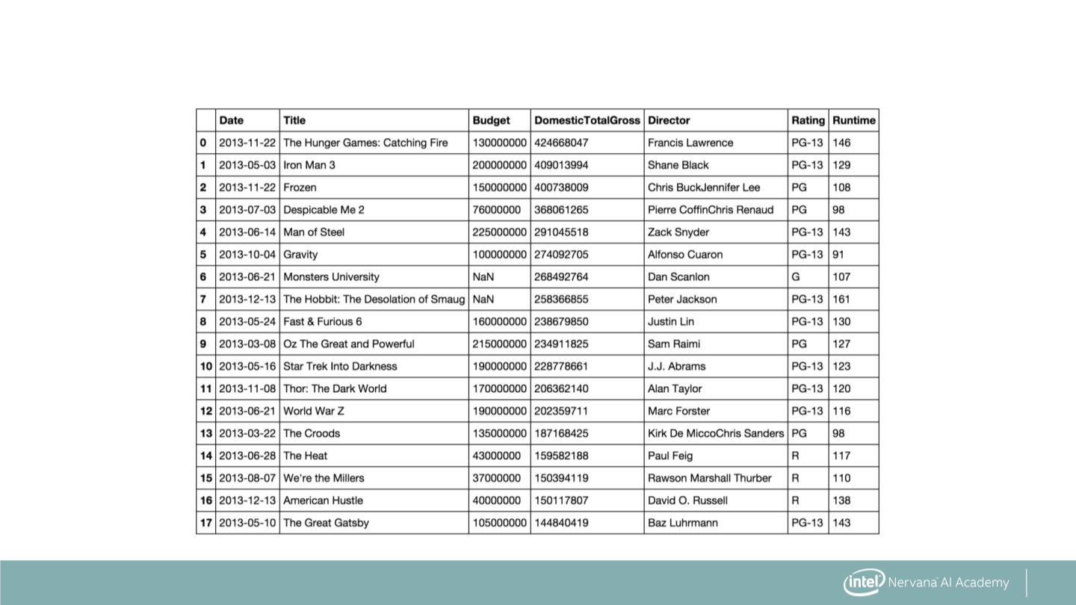
Training and Test Splits
7

Slide 7
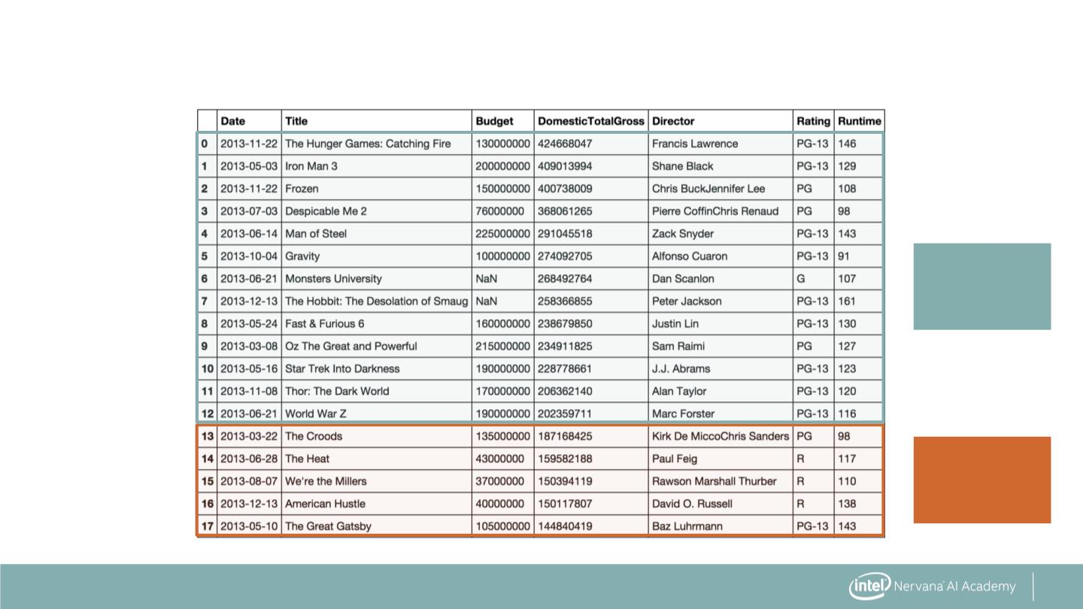
Training and Test Splits
Training
data
Test
data
8

Slide 8
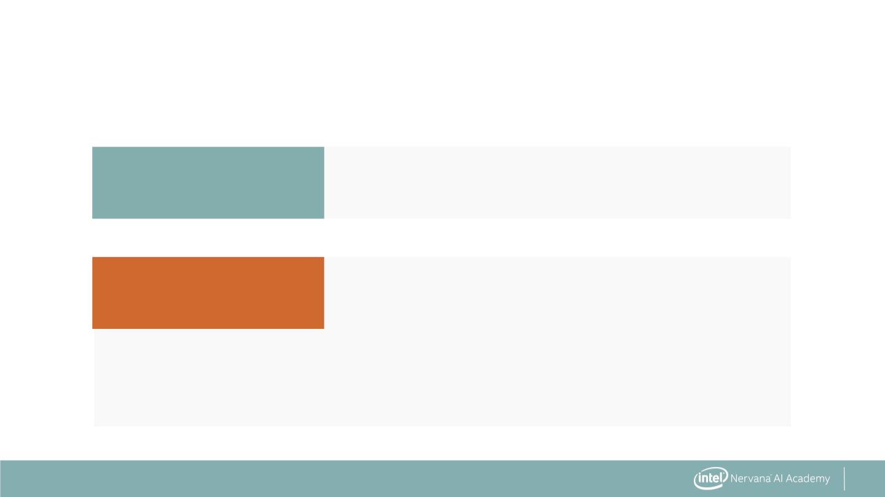
Using Training and Test Data
Training data
Test data
fit the model
measure performance
- predict label with model
- compare with actual value
- measure error
9

Slide 9
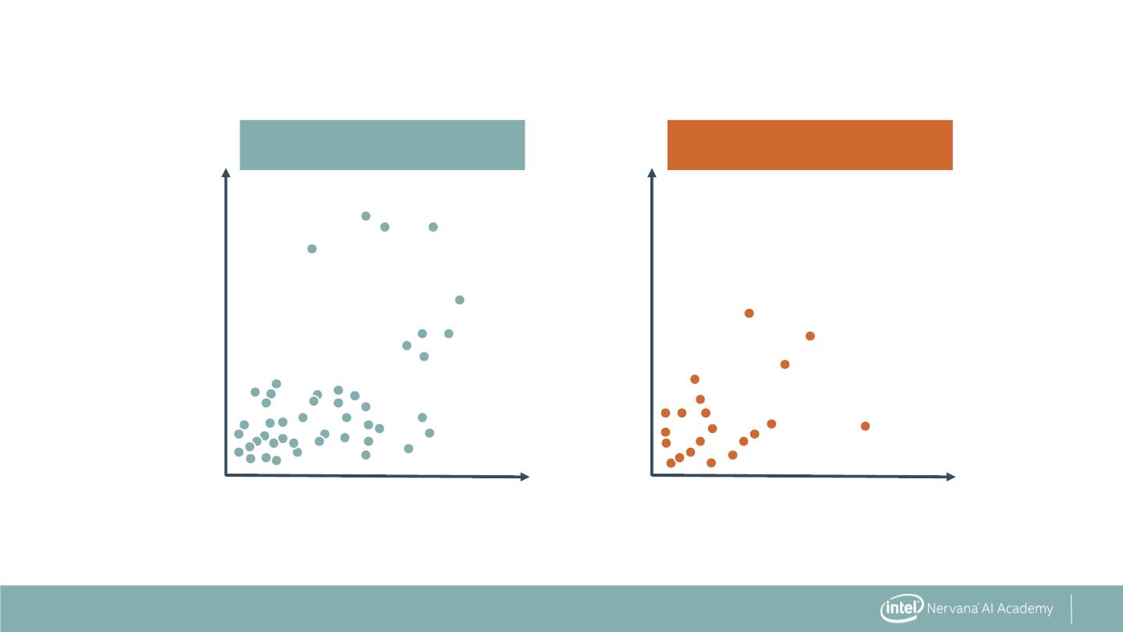
Using Training and Test Data
Training data
Test data
x10⁸
x10⁸
4.0
3.0
2.0
1.0
4.0
3.0
2.0
1.0
0.0
1.0
2.0
x10⁸
0.0
1.0
2.0
x10⁸
10

Slide 10

Using Training and Test Data
Training data
Test data
x10⁸
x10⁸
4.0
3.0
2.0
1.0
4.0
3.0
2.0
1.0
0.0
1.0
2.0
x10⁸
0.0
1.0
2.0
x10⁸
Fit the model
11

Slide 11
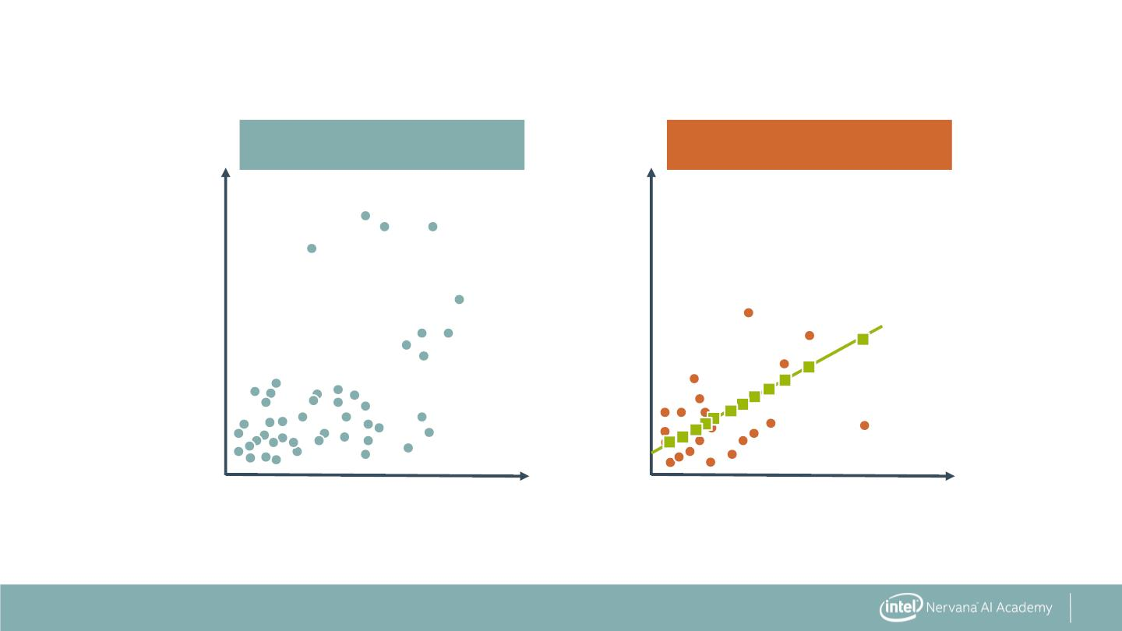
Using Training and Test Data
Training data
Test data
x10⁸
x10⁸
4.0
3.0
2.0
1.0
4.0
3.0
2.0
1.0
0.0
1.0
2.0
x10⁸
0.0
1.0
2.0
x10⁸
Make predictions
12

Slide 12
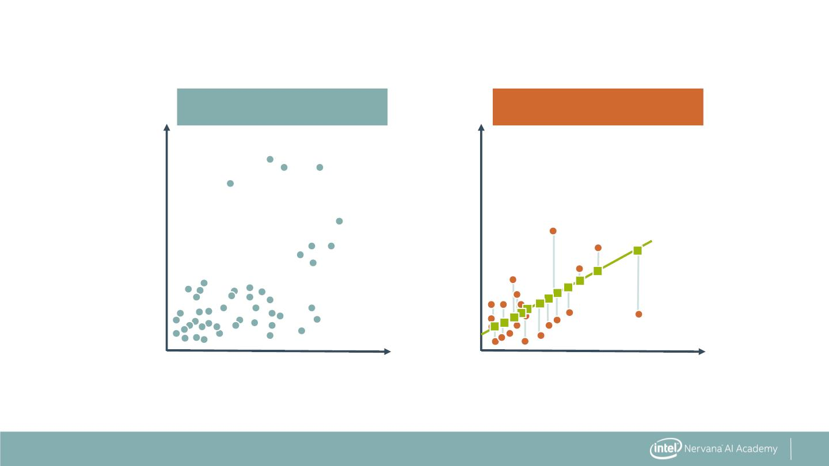
Using Training and Test Data
Training data
Test data
x10⁸
x10⁸
4.0
3.0
2.0
1.0
4.0
3.0
2.0
1.0
0.0
1.0
2.0
x10⁸
0.0
1.0
2.0
x10⁸
Measure error
13

Slide 13
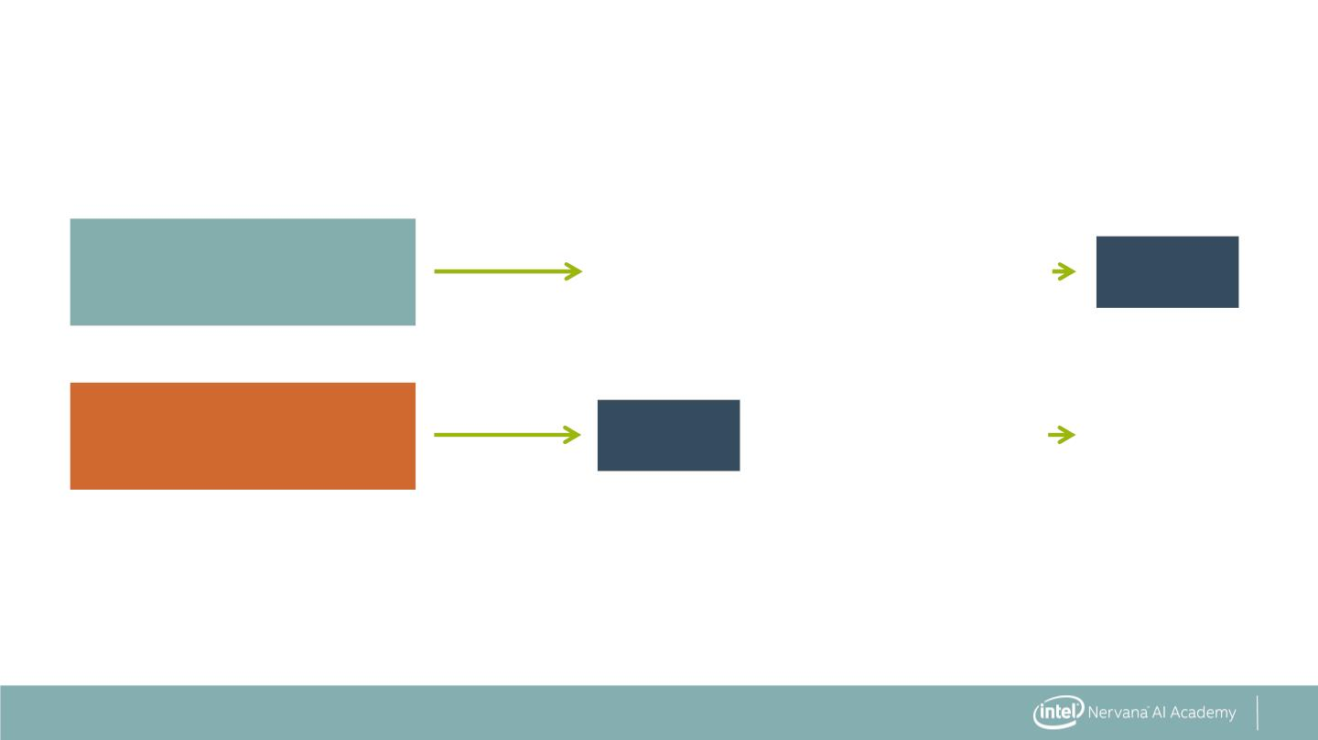
Fitting Training and Test Data
Training data
X_train
KNN( X_train, Y_train ).fit()
model
Y_train
Test data
X_test
model
.predict ( X_test ) Y_predict
14

Slide 14
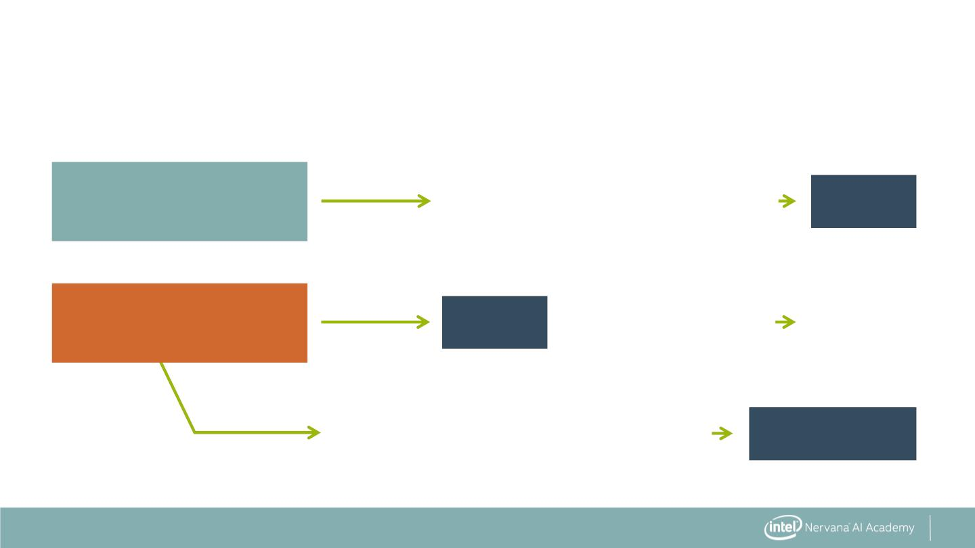
Fitting Training and Test Data
Training data
X_train
KNN( X_train, Y_train ).fit()
model
Y_train
Test data
X_test
model
.predict ( X_test ) Y_predict
error_metric( Y_test, Y_predict )
Test error
Y_test
15

Slide 15

Train and Test Splitting: The Syntax
Import the train and test split function
from sklearn.model_selection import train_test_split
16

Slide 16
Train and Test Splitting: The Syntax
Import the train and test split function
from sklearn.model_selection import train_test_split
Split the data and put 30% into the test set
train, test = train_test_split(data, test_size=0.3)
17

Slide 17
Train and Test Splitting: The Syntax
Import the train and test split function
from sklearn.model_selection import train_test_split
Split the data and put 30% into the test set
train, test = train_test_split(data, test_size=0.3)
Other method for splitting data:
from sklearn.model_selection import ShuffleSplit
18

Slide 18
Beyond a Single Test Set: Cross Validation
Training
data
validation
data
19

Slide 19
Beyond a Single Test Set: Cross Validation
Training data
Test data
x10⁸
x10⁸
4.0
3.0
2.0
1.0
4.0
3.0
2.0
1.0
0.0
1.0
2.0
x10⁸
0.0
1.0
2.0
x10⁸
Best model for this test set
20

Slide 20

Beyond a Single Test Set: Cross Validation
Training
data 1
validation
data 1
21

Slide 21
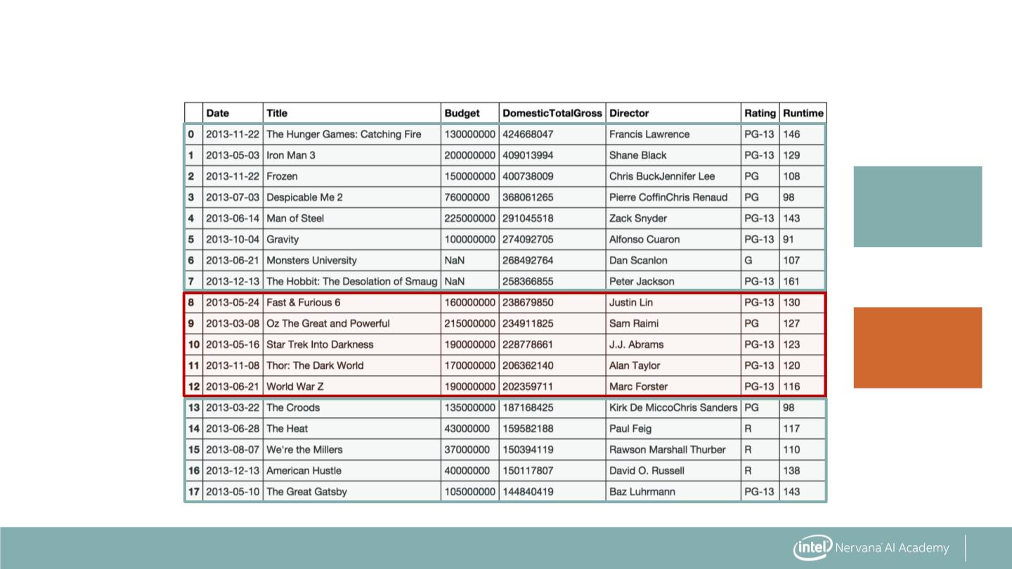
Beyond a Single Test Set: Cross Validation
Training
data 2
Validation
data 2
22

Slide 22
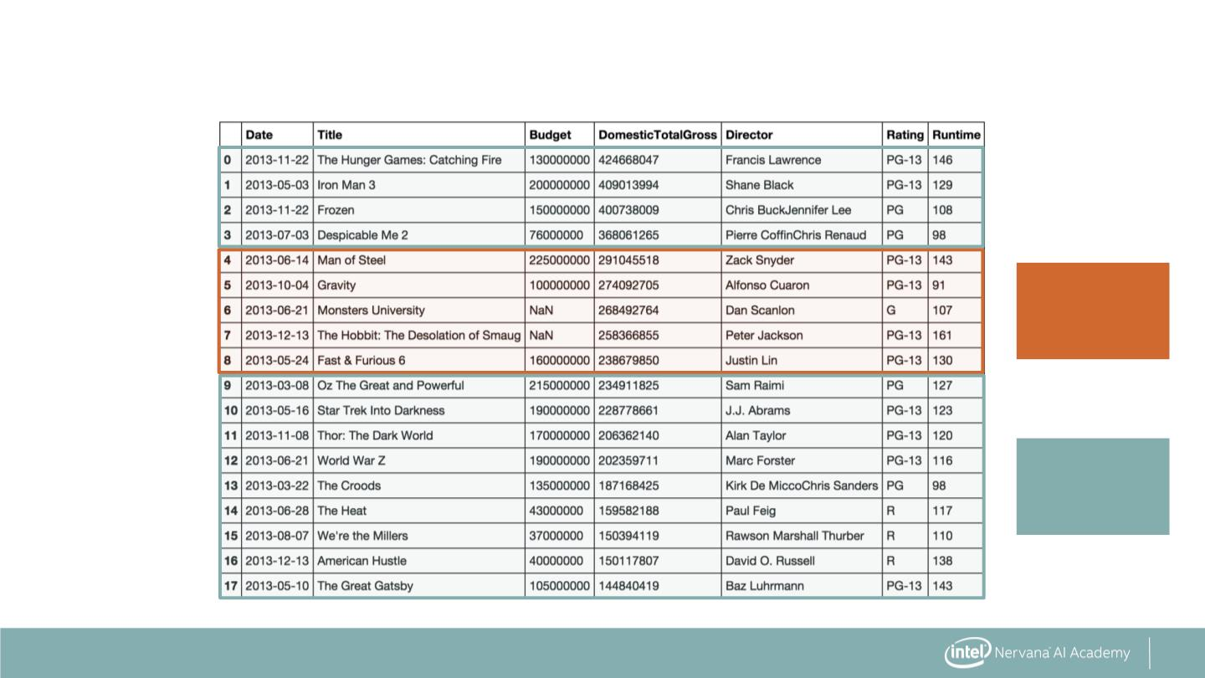
Beyond a Single Test Set: Cross Validation
Validation
data 3
Training
data 3
23

Slide 23
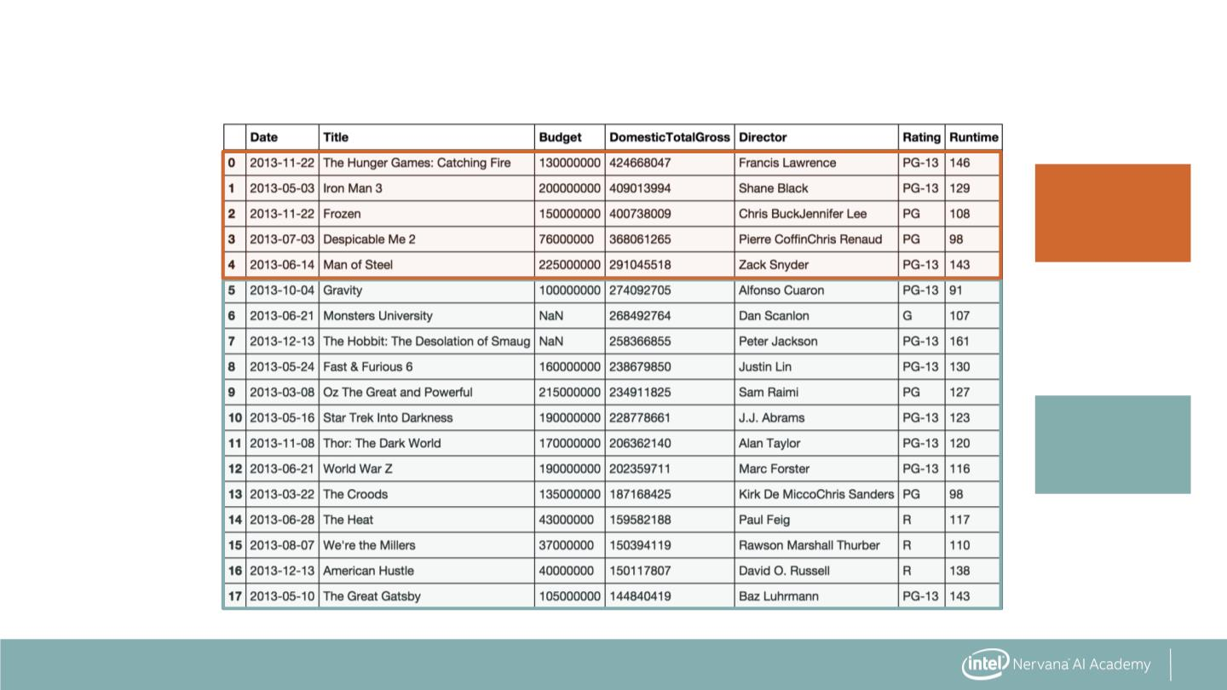
Beyond a Single Test Set: Cross Validation
Validation
data 4
Training
data 4
24

Slide 24
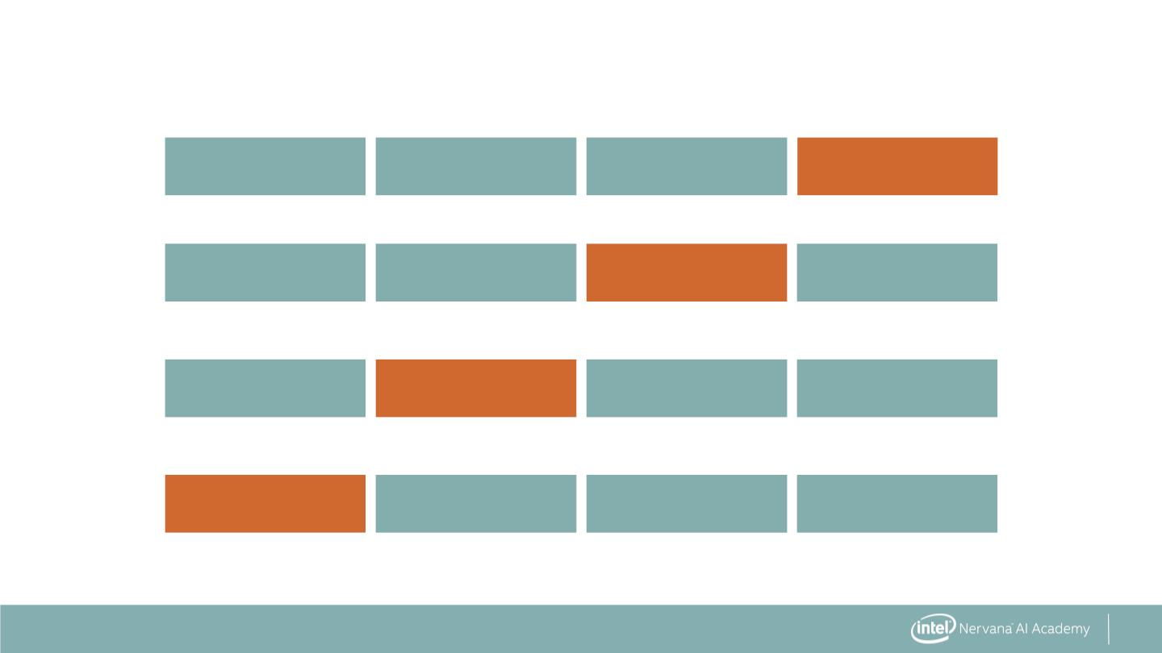
Beyond a Single Test Set: Cross Validation
Training split Training split Training split Test split
+
Training split Training split Test split Training split
+
Training split Test split Training split Training split
+
Test split Training split Training split Training split
25

Slide 25
Beyond a Single Test Set: Cross Validation
Training split Training split Training split Test split
+
Training split Training split Test split Training split
+
Training split Test split Training split Training split
+
Test split Training split Training split Training split
Average cross validation results
26

Slide 26
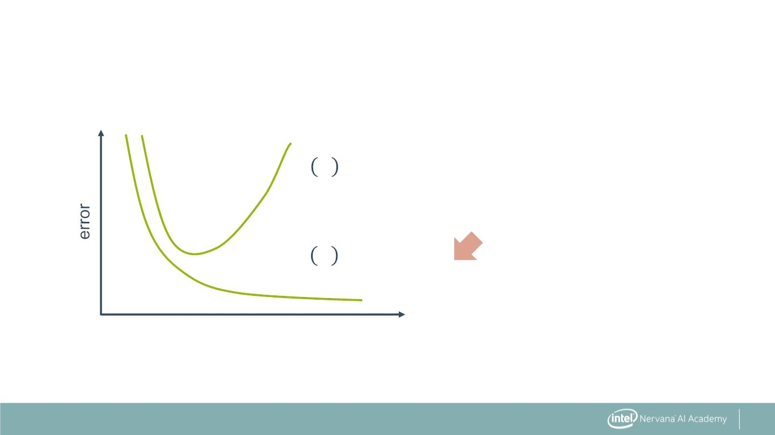
Model Complexity vs Error
퐽 휃
푐푣
cross validation error
퐽_{푡푟푎푖푛}
휃
training error
27

Slide 27
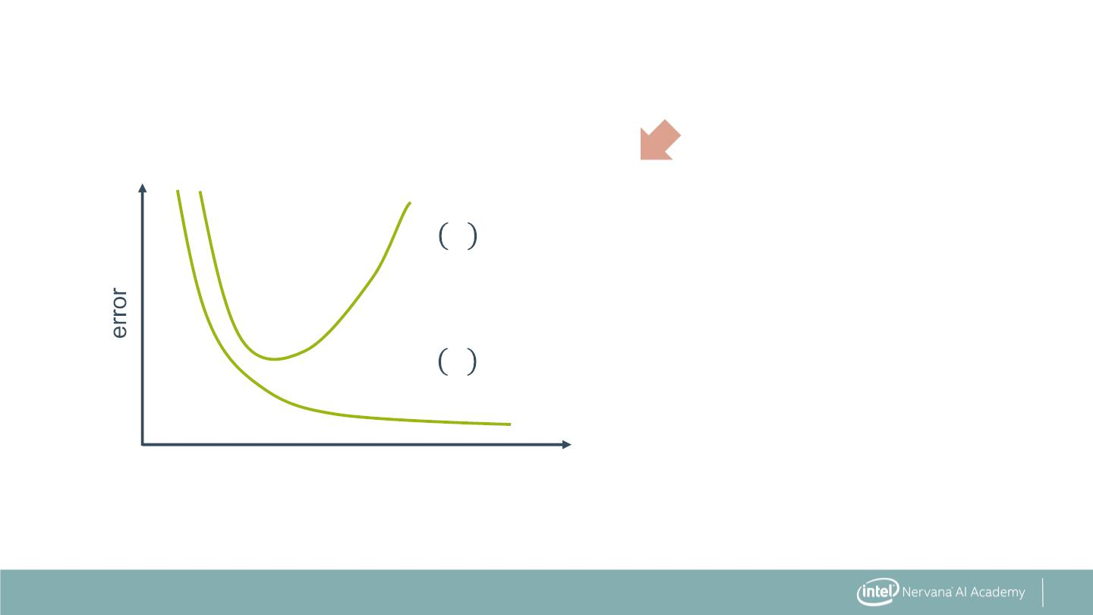
Model Complexity vs Error
퐽 휃
푐푣
cross validation error
퐽_{푡푟푎푖푛}
휃
training error
28

Slide 28
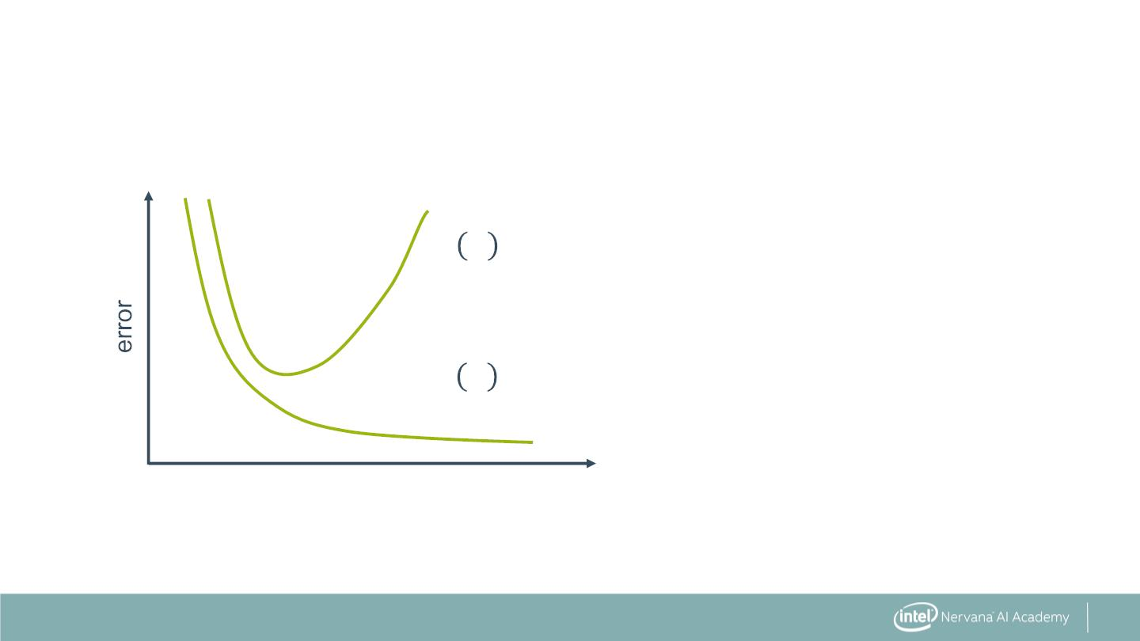
Model Complexity vs Error
퐽 휃
푐푣
cross validation error
퐽_{푡푟푎푖푛}
휃
training error
29

Slide 29
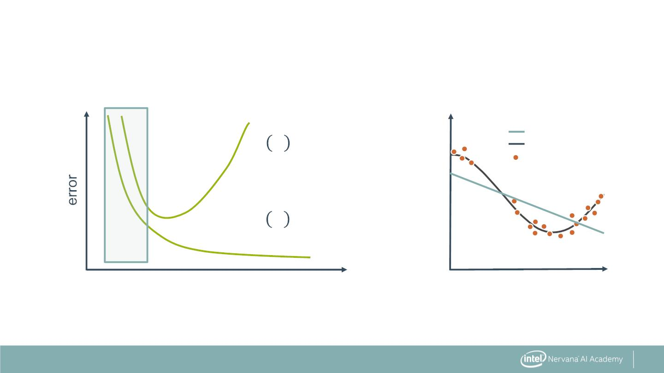
Model Complexity vs Error
Polynomial Degree = 1
Model
True Function
Samples
퐽 휃
cross validation error
푐푣
Y
퐽_{푡푟푎푖푛}
휃
training error
X
Underfitting: training and cross validation error are high
30

Slide 30
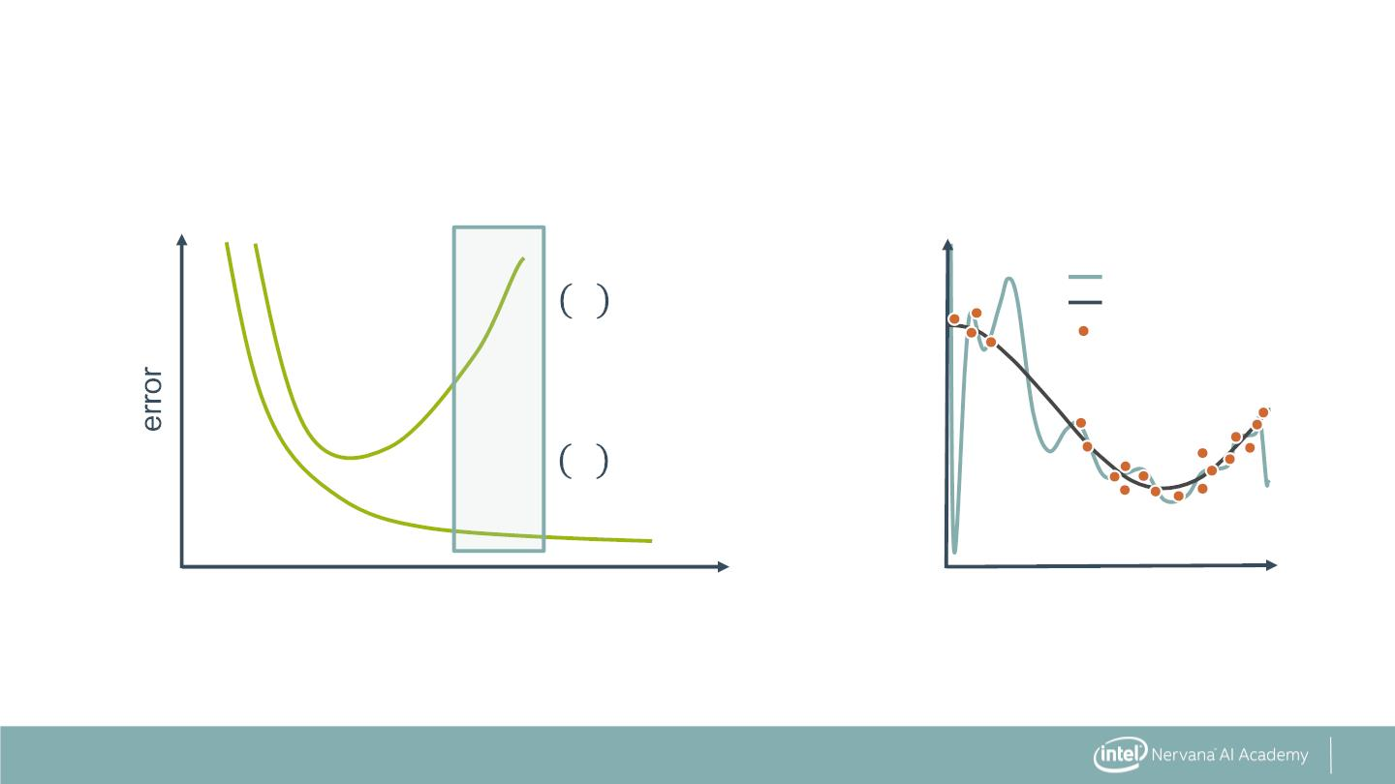
Model Complexity vs Error
Polynomial Degree = 15
Model
True Function
Samples
_{푣} 휃
oss validation error
Y
_{푛} 휃
ng error
X
Overfitting: training error is low, cross validation is high
31

Slide 31
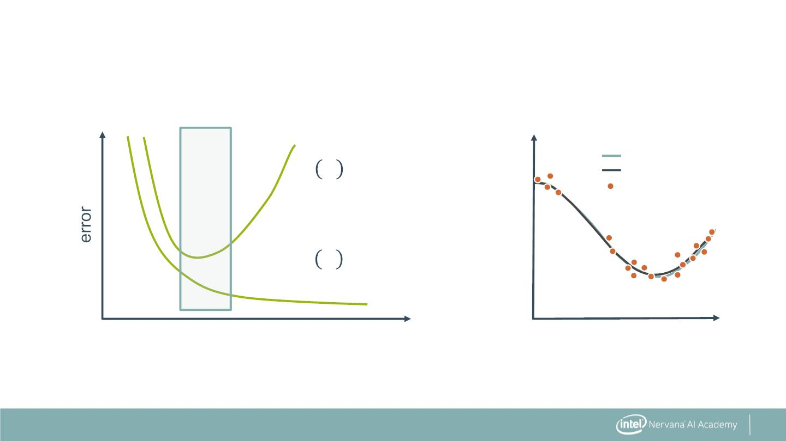
Model Complexity vs Error
Polynomial Degree = 4
Model
True Function
Samples
퐽 휃
cross validation error
푐푣
Y
퐽_{푡푟푎푖푛}
휃
training error
X
Just right: training and cross validation errors are low
32

Slide 32
Cross Validation: The Syntax
Import the train and test split function
from sklearn.model_selection import cross_val_score
33

Slide 33
Cross Validation: The Syntax
Import the train and test split function
from sklearn.model_selection import cross_val_score
Perform cross-validation with a given model
cross_val = cross_val_score(KNN, X_data, y_data, cv=4,
scoring='neg_mean_squared_error')
34

Slide 34
Cross Validation: The Syntax
Import the train and test split function
from sklearn.model_selection import cross_val_score
Perform cross-validation with a given model
cross_val = cross_val_score(KNN, X_data, y_data, cv=4,
scoring='neg_mean_squared_error')
Other methods for cross validation:
from sklearn.model_selection import KFold, StratifiedKFold
35

Slide 35
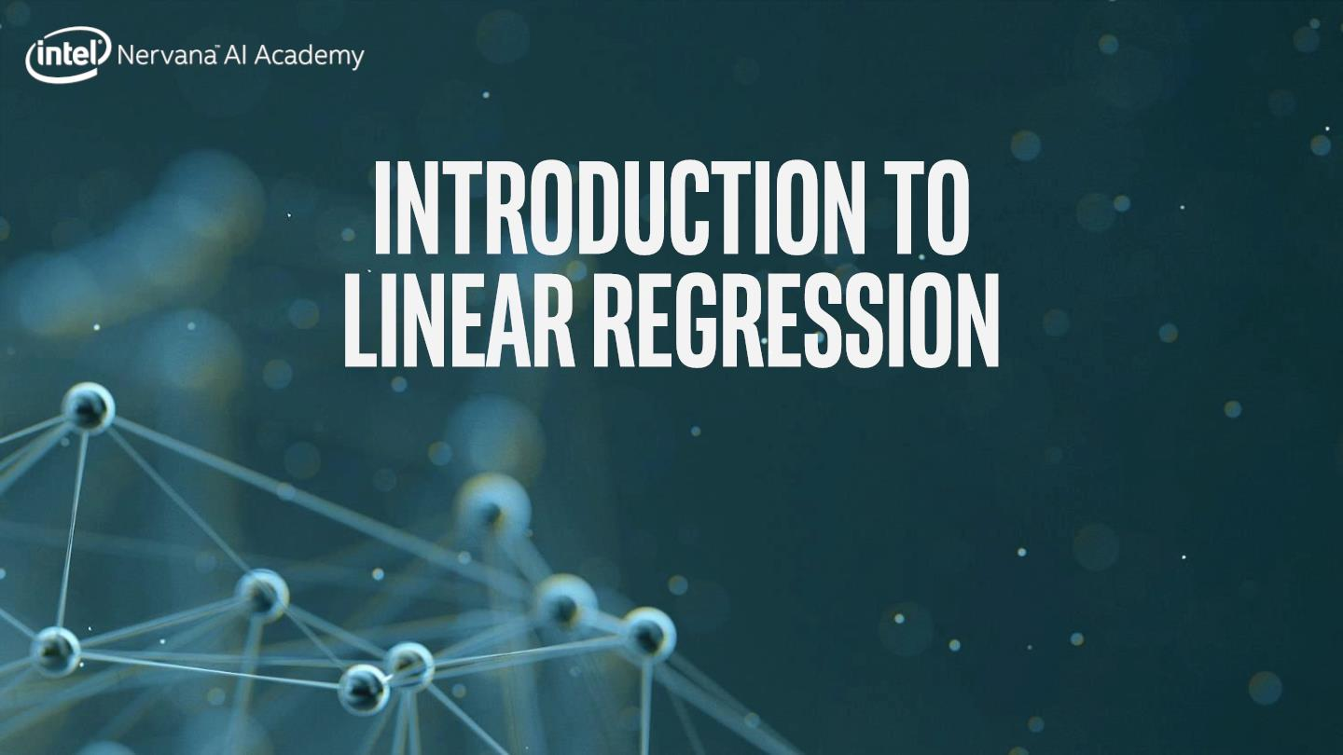

Slide 36
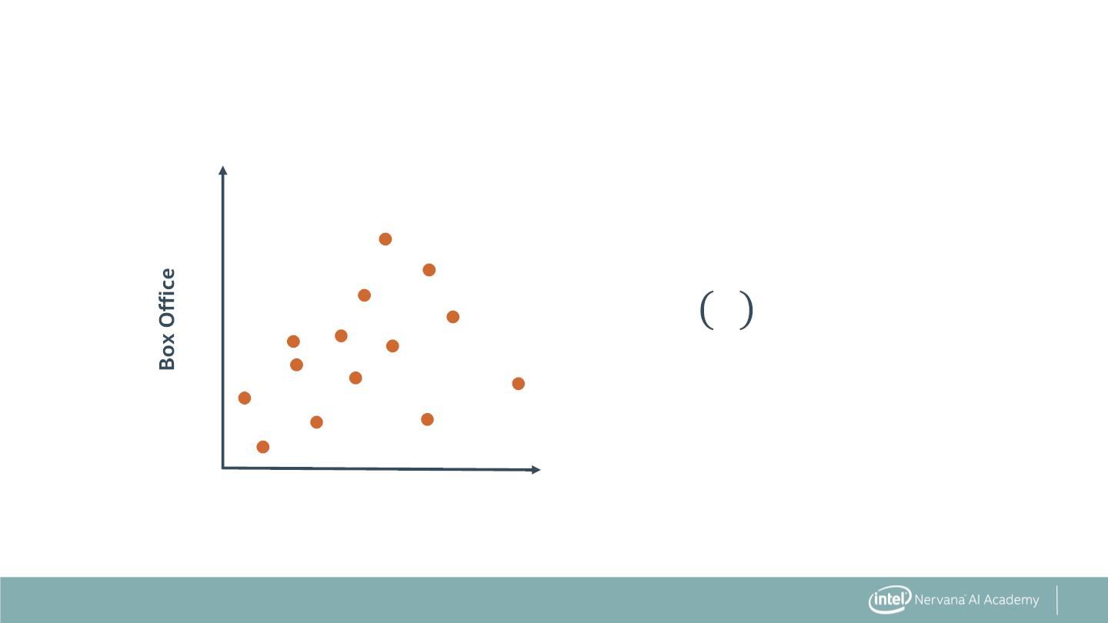
Introduction to Linear Regression
x10⁸
2.0
1.0
푦 푥 = ꢀ + ꢀ 푥
훽
0
1
x10⁸
0.0
1.0
2.0
Budget
37

Slide 37
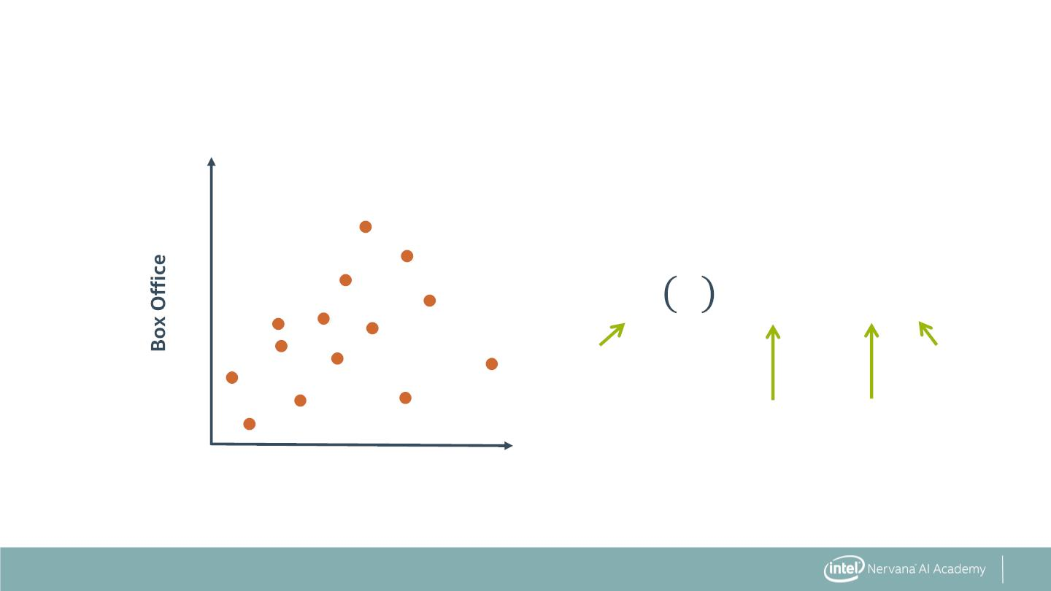
Introduction to Linear Regression
x10⁸
2.0
1.0
푦 푥 = ꢀ + ꢀ 푥
훽
0
1
box
office
movie
budget
revenue
coefficient coefficient
0
1
x10⁸
0.0
1.0
2.0
Budget
38

Slide 38
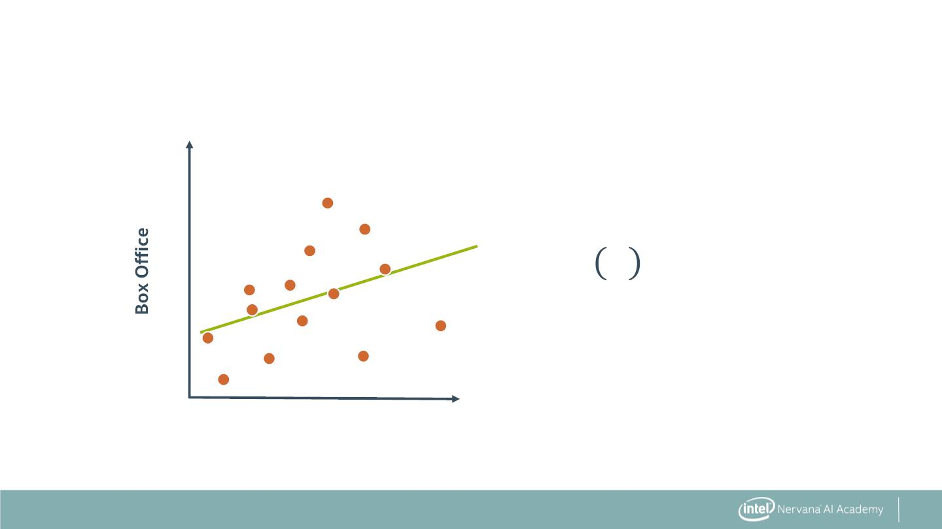
Introduction to Linear Regression
x10⁸
2.0
1.0
푦 푥 = ꢀ + ꢀ 푥
훽
0
1
, ꢀ
= 80 million = 0.6
ꢀ₀
1
x10⁸
0.0
1.0
2.0
Budget
39

Slide 39
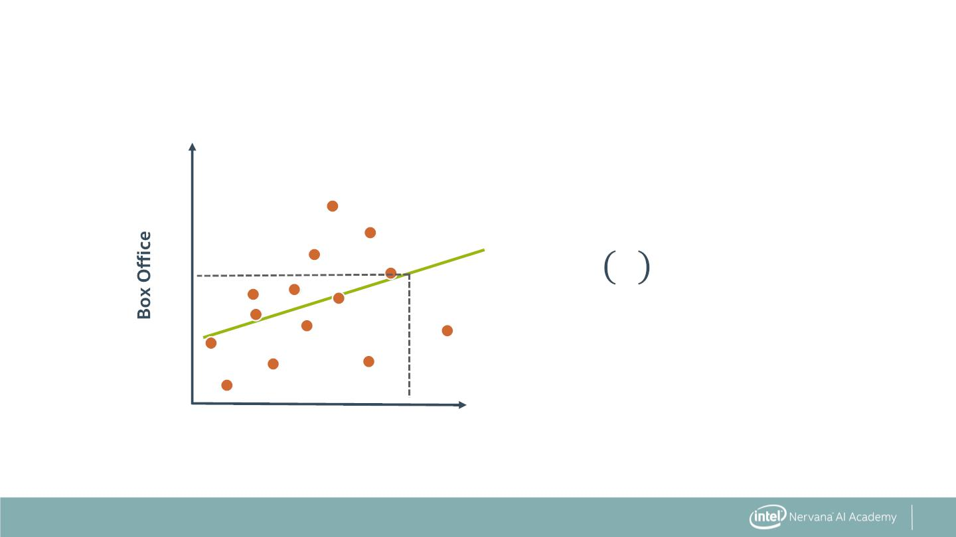
Predicting from Linear Regression
x10⁸
2.0
1.0
푦 푥 = ꢀ + ꢀ 푥
훽
0
1
, ꢀ
= 80 million = 0.6
ꢀ₀
1
x10⁸
Predict 175 Million Gross for
160 Million Budget
0.0
1.0
2.0
Budget
40

Slide 40
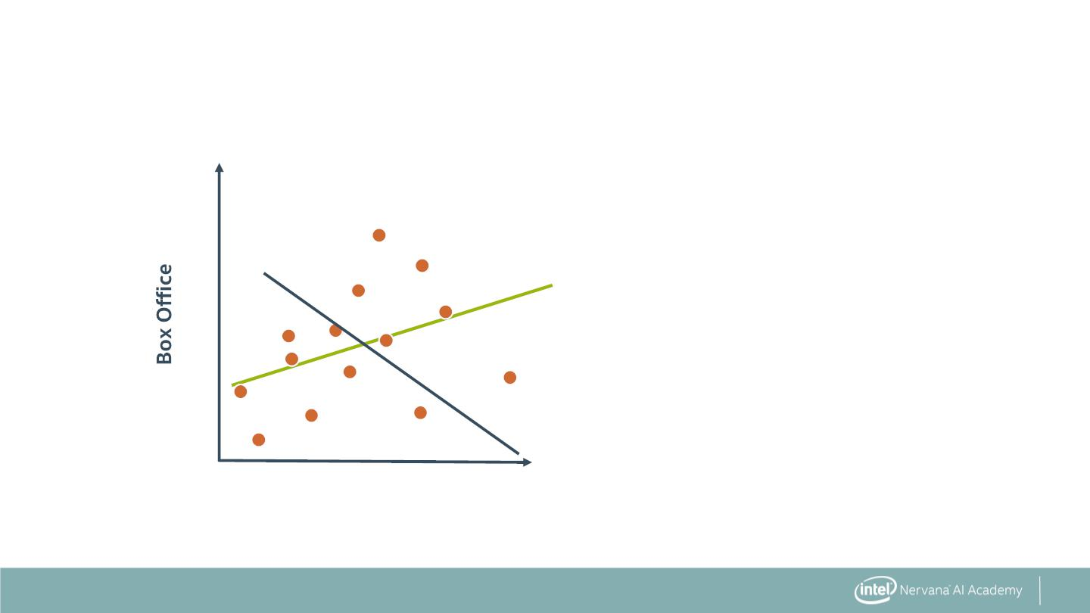
Which Model Fits the Best?
x10⁸
2.0
1.0
x10⁸
0.0
1.0
2.0
Budget
41

Slide 41
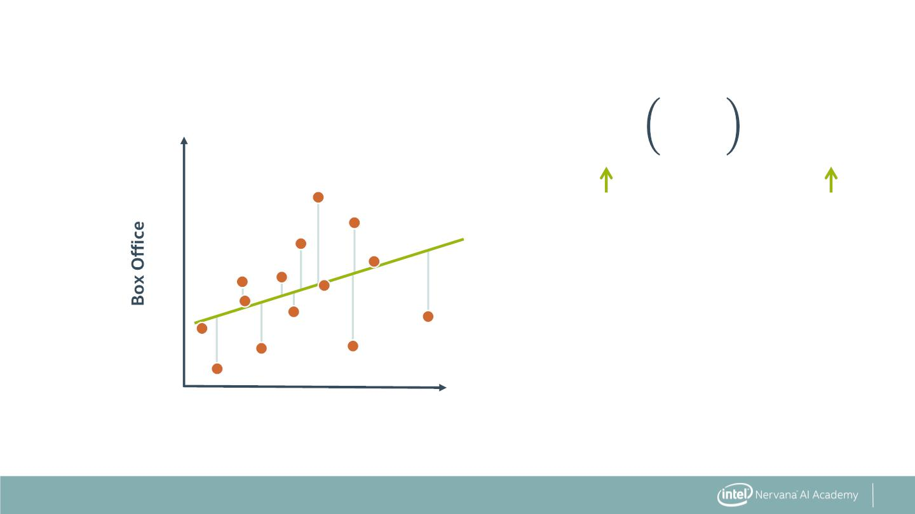
Calculating the Residuals
(푖)
표푏푠
(푖)
표푏푠
푦 푥 − 푦
훽
x10⁸
Predicted
value
Observe
d value
2.0
1.0
x10⁸
0.0
1.0
2.0
Budget
42

Slide 42
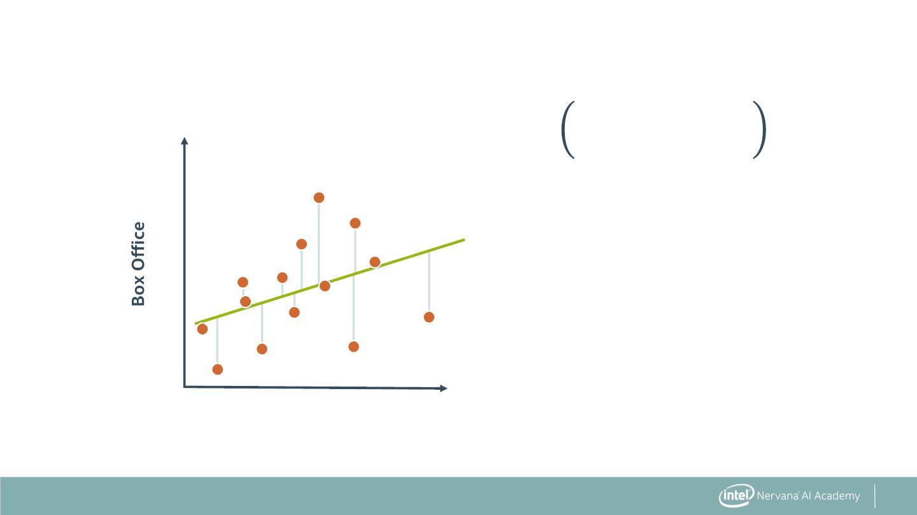
Calculating the Residuals
(푖)
표푏푠
(푖)
표푏푠
ꢀ + ꢀ 푥 − 푦
0
1
x10⁸
2.0
1.0
x10⁸
0.0
1.0
2.0
Budget
43

Slide 43
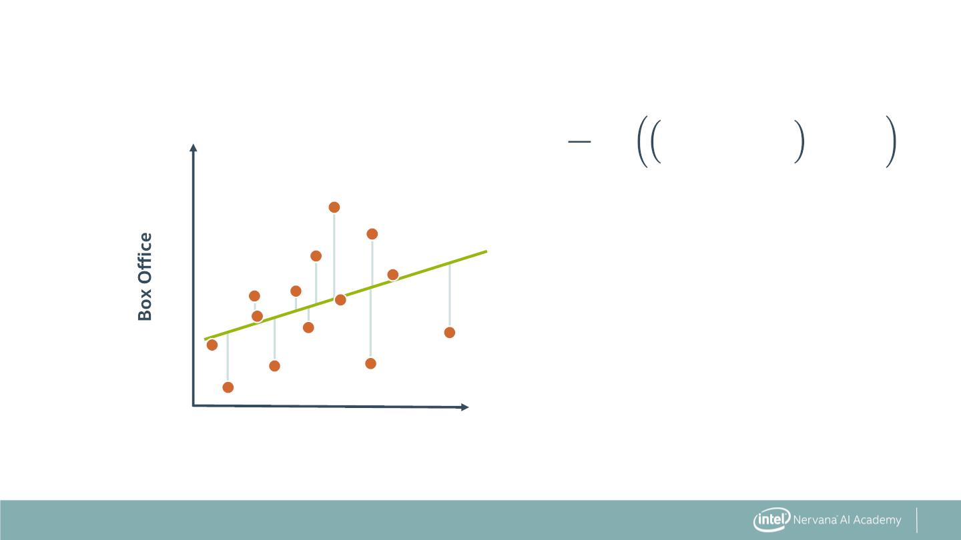
Mean Squared Error
ꢃ
ꢁ
2
(푖)
표푏푠
(푖)
표푏푠
ꢀ + ꢀ 푥
− 푦
푚
0
1
푖ꢂ1
x10⁸
2.0
1.0
x10⁸
0.0
1.0
2.0
Budget
44

Slide 44

Minimum Mean Squared Error
ꢃ
ꢁ
2
(푖)
표푏푠
(푖)
표푏푠
min ꢀ + ꢀ 푥
− 푦
훽 ,훽
ꢄ
푚
ꢅ
0
1
푖ꢂ1
x10⁸
2.0
1.0
x10⁸
0.0
1.0
2.0
Budget
45

Slide 45
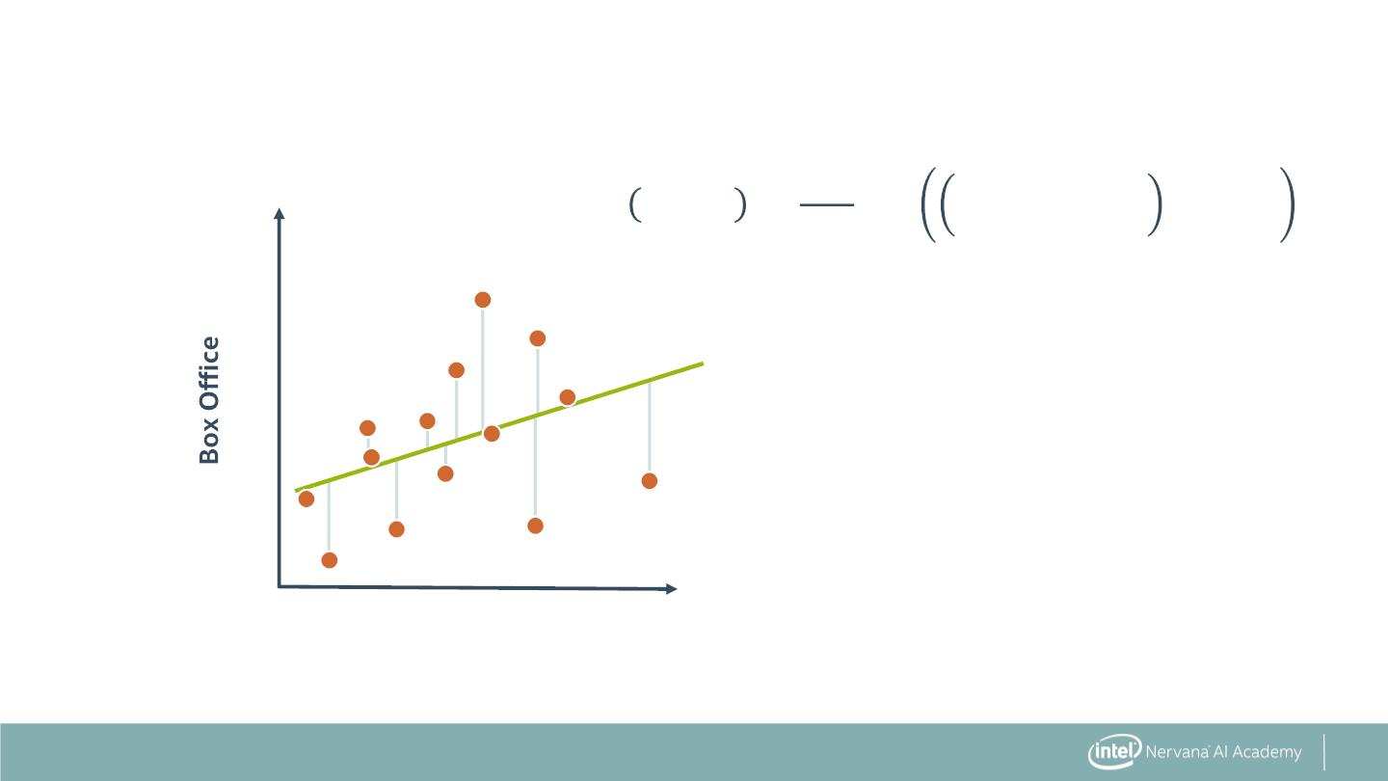
Cost Function
ꢃ
ꢁ
2
(푖)
표푏푠
(푖)
표푏푠
퐽 ꢀ , ꢀ =
ꢀ + ꢀ 푥
− 푦
0
1
ꢆ푚
0
1
푖ꢂ1
x10⁸
2.0
1.0
x10⁸
0.0
1.0
2.0
Budget
46

Slide 46
Modelling Best Practice
. Use cost function to fit model
. Develop multiple models
. Compare results and choose best one
47

Slide 47
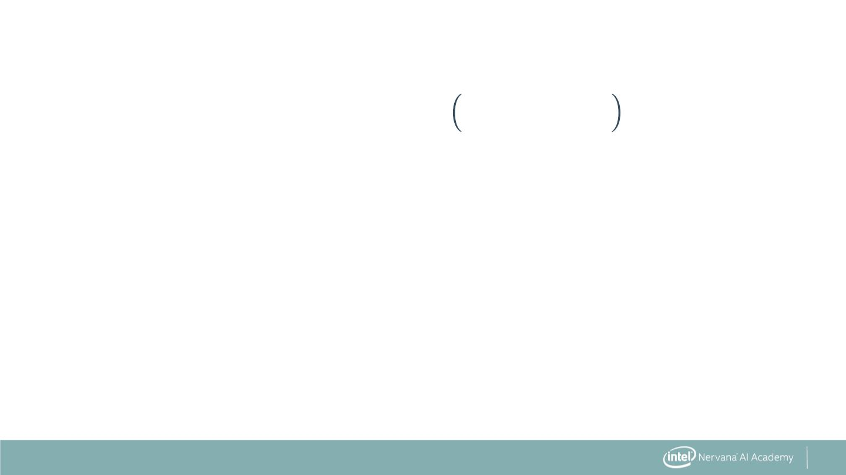
Other Model Metrics
ꢃ
(푖)
표푏푠
2
Sum of Squared Error (SSE):
(푖)
푦 (푥 ) − 푦
훽
푖ꢂ1
48

Slide 48
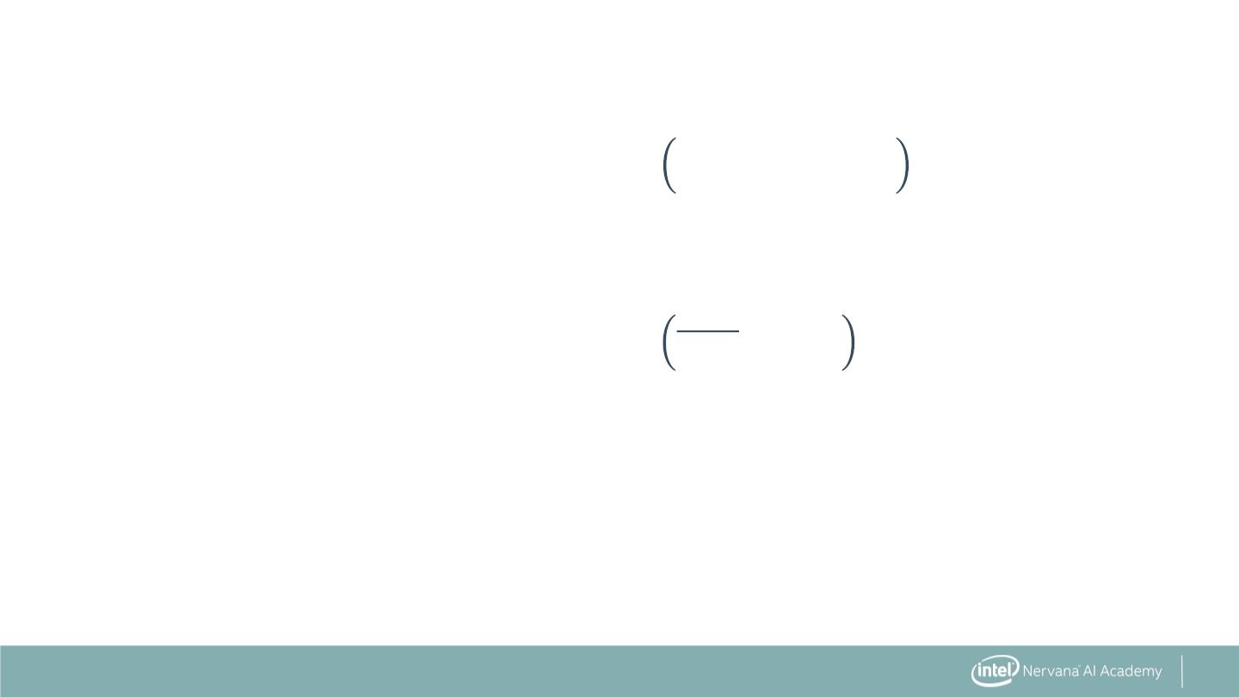
Other Measures of Error
ꢃ
(푖)
표푏푠
2
Sum of Squared Error (SSE):
(푖)
푦 (푥 ) − 푦
훽
푖ꢂ1
ꢃ
(푖)
표푏푠
2
Total Sum of Squares (TSS):
푦 − 푦
표푏푠
푖ꢂ1
49

Slide 49
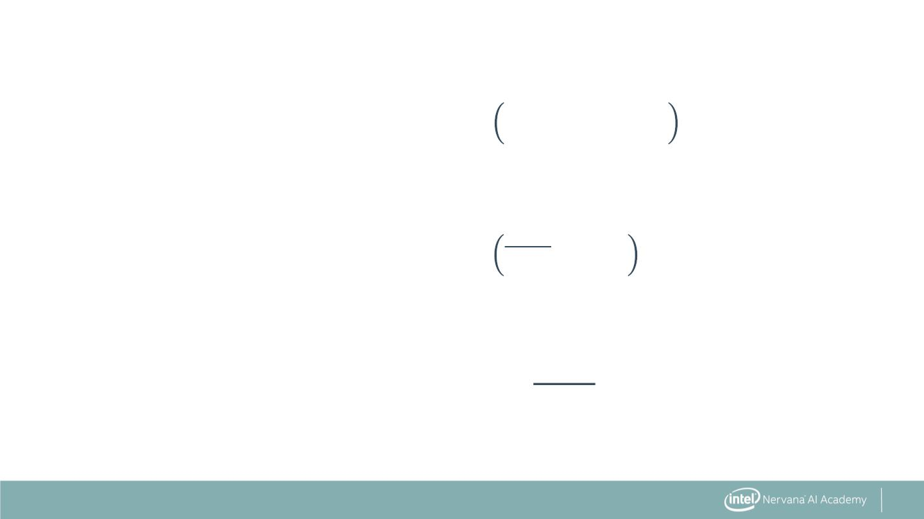
Other Measures of Error
ꢃ
(푖)
표푏푠
2
Sum of Squared Error (SSE):
(푖)
푦 (푥 ) − 푦
훽
푖ꢂ1
ꢃ
(푖)
표푏푠
2
Total Sum of Squares (TSS):
Correlation Coefficient (R2):
푦 − 푦
표푏푠
푖ꢂ1
푆푆퐸
ꢁ − _{푇푆푆}
50

Slide 50
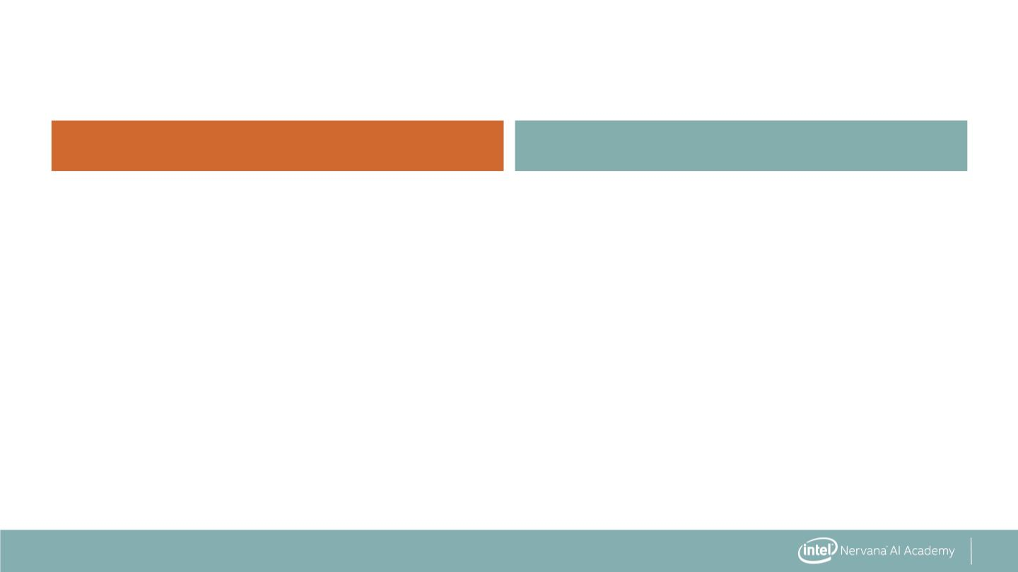
Comparing Linear Regression and KNN
Linear regression
K nearest neighbors
. Fitting involves minimizing cost
function (slow)
. Fitting involves storing training
data (fast)
51

Slide 51
Comparing Linear Regression and KNN
Linear regression
K nearest neighbors
. Fitting involves minimizing cost
function (slow)
. Fitting involves storing training
data (fast)
. Model has few parameters
. Model has many parameters
(memory efficient)
(memory intensive)
52

Slide 52
Comparing Linear Regression and KNN
Linear regression
K nearest neighbors
. Fitting involves minimizing cost
function (slow)
. Fitting involves storing training
data (fast)
. Model has few parameters
. Model has many parameters
(memory efficient)
(memory intensive)
. Prediction involves calculation
. Prediction involves finding
closest neighbors (slow)
(fast)
53

Slide 53
Linear Regression: The Syntax
Import the class containing the regression method
from sklearn.linear_model import LinearRegression
54

Slide 54
Linear Regression: The Syntax
Import the class containing the regression method
from sklearn.linear_model import LinearRegression
Create an instance of the class
LR = LinearRegression()
55

Slide 55
Linear Regression: The Syntax
Import the class containing the regression method
from sklearn.linear_model import LinearRegression
Create an instance of the class
LR = LinearRegression()
Fit the instance on the data and then predict the expected value
LR = LR.fit(X_train, y_train)
y_predict = LR.predict(X_test)
56

Slide 56
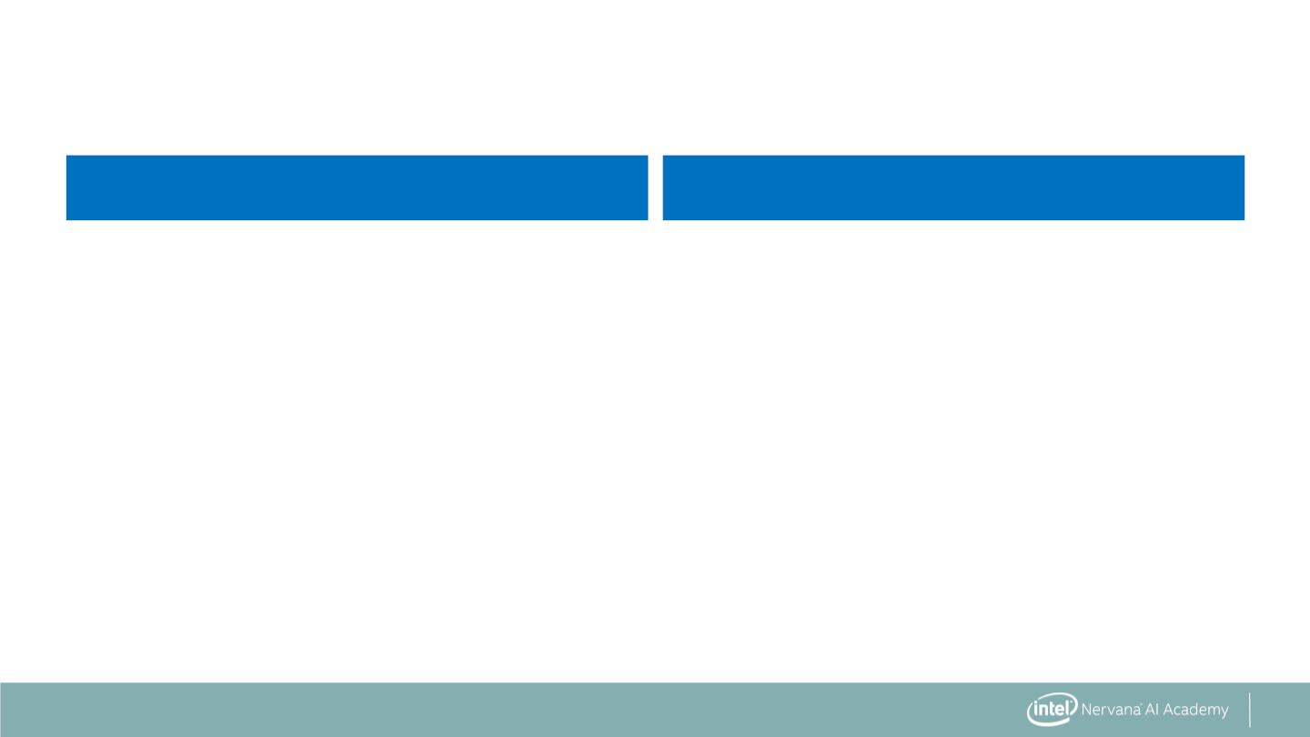
Feature Types
Feature type
transformation
. Continuous: numerical values
63

Slide 57
Feature Types
Feature type
transformation
. Continuous: numerical values
. Standard Scaling, Min-Max Scaling
64

Slide 58
Feature Types
Feature type
transformation
. Continuous: numerical values
. Standard Scaling, Min-Max Scaling
. One-hot encoding (0, 1)
. Nominal: categorical, unordered
features (True or False)
from sklearn.preprocessing import LabelEncoder, LabelBinarizer, OneHotEncoder
65

Slide 59
Feature Types
Feature type
transformation
. Continuous: numerical values
. Standard Scaling, Min-Max Scaling
. One-hot encoding (0, 1)
. Nominal: categorical, unordered
features (True or False)
. Ordinal: categorical, ordered
. Ordinal encoding (0, 1, 2, 3)
features (movie ratings)
from sklearn.feature_extraction import DictVectorizer
from pandas import get_dummies
66

Slide 60


